Slide 1

Developing & Using Libraries
Describe the different types of library
Discuss when to use libraries
Outline how to use libraries
Explain how DLLs work
Compare static libraries & DLLs

Slide 2
Linkers and Loaders
The Problem
  Programs use symbolic names
    Variables, functions
  Machine code requires physical addresses
  Addresses are not known at compile time
    Symbols may be declared in other files
    OS may want to place program “anywhere”
Linker – combines object files -> exe
  Matches names used and declared across files
Loader – places program into memory
  Ensures absolute addresses are correct

Slide 3
Linker
Data
Code
(Text)
Data
Code
(Text)
0
1
4
0
4
Call
F2
x
myarray
main
array2
F1
F2
filea.obj
fileb.obj
Code
(Text)
Data
.exe/Memory
0
3
6
7
10

Slide 4
What is a library?
A compiled collection of
  Functions,
  Classes,
  Other resources, e.g. bitmaps and fonts
Can be incorporated into programs
  without knowing how they work
Supports
  Independent development & efficient reuse
Static & Dynamically Linked Libraries
  When the library is tied into the program
    By the linker or the loader

Slide 5
Static link libraries
Code from library added to executable
Linker
  Take machine code from the library file
  Integrate it into the program .exe
Each program has its copy of the function
Static
Library
The library isn’t involved at run time.
Code has already been included in exe.
Proga.exe
Library
Function
Library
Function
Progb.exe
Library
Function

Slide 6
Static link libraries
Programming languages provide libraries of standard functions.
Examples of C++ standard libraries
  ceil() & floor() functions in <math> header
  cout, cin in <iostream> header
MS C++ library files use .lib extension

Slide 7
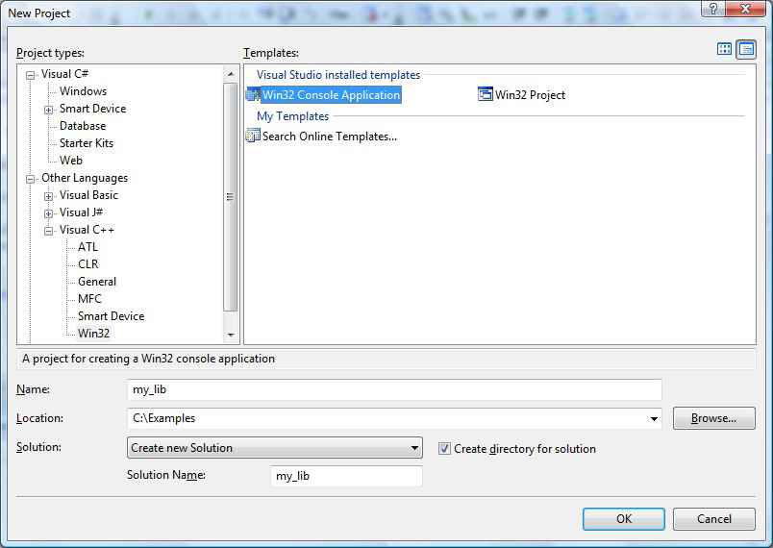
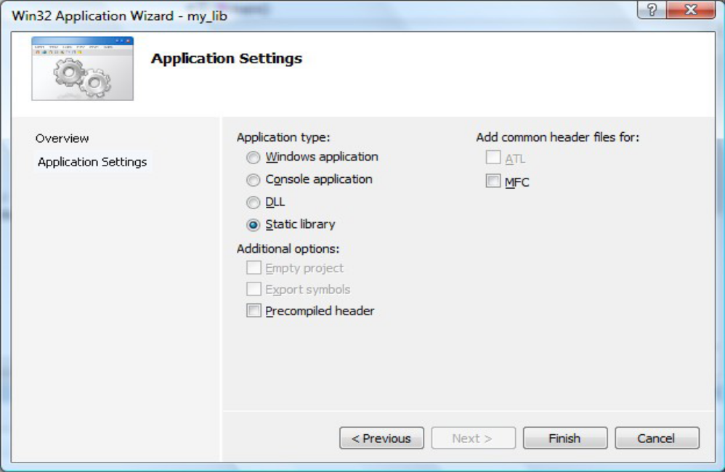
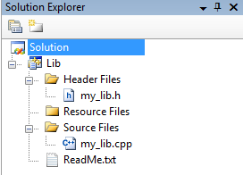
Creating a Static Library
Create Win32 Console Application
Select Static library
Deselect Precompiled header
Press Finish to create the project
Change configuration type to Static Library
Add classes & functions

Slide 8
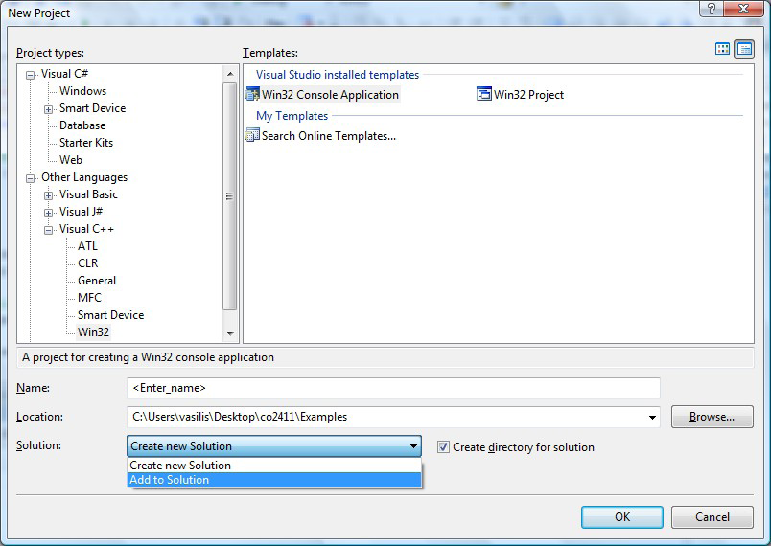
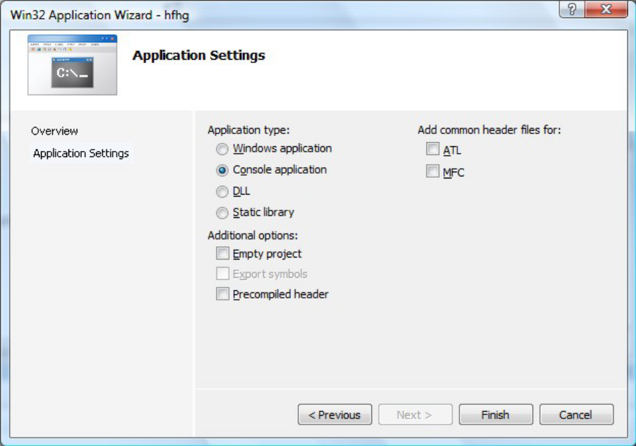
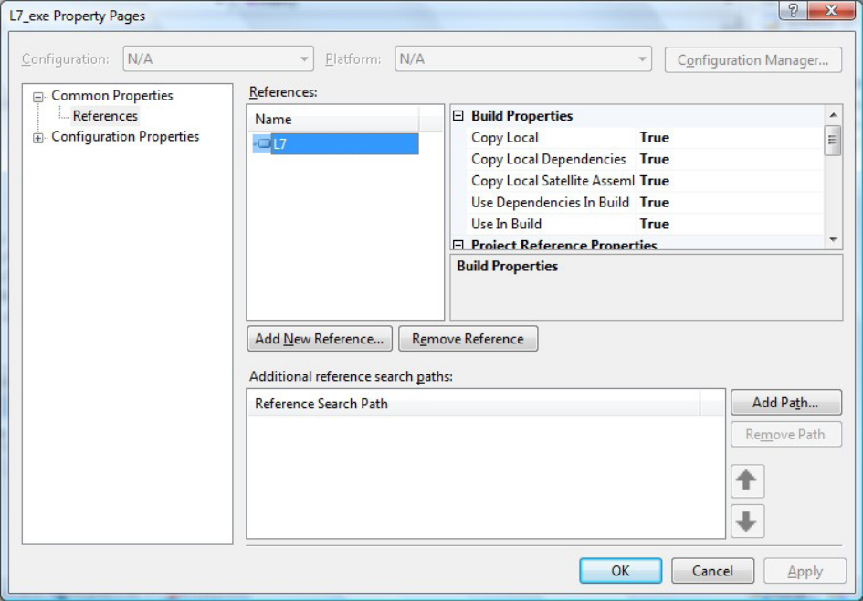
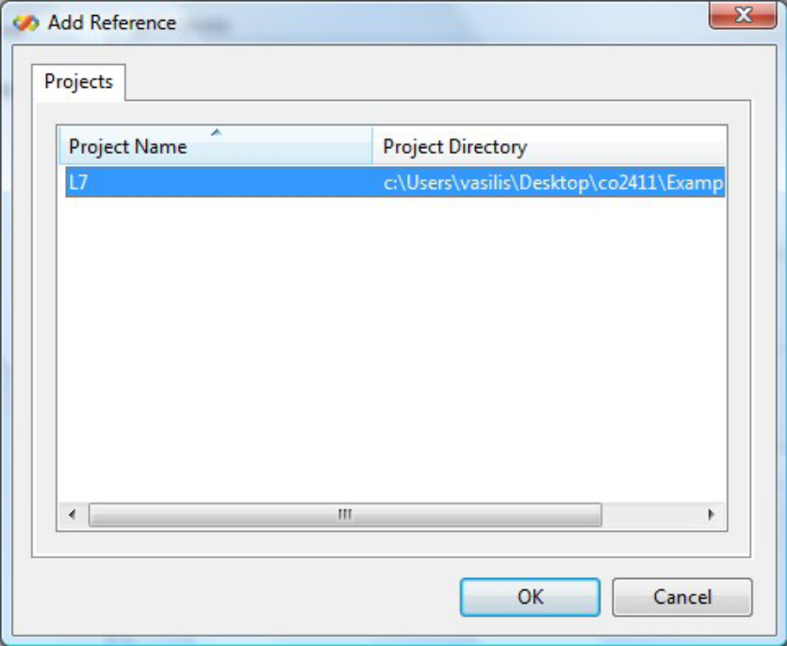
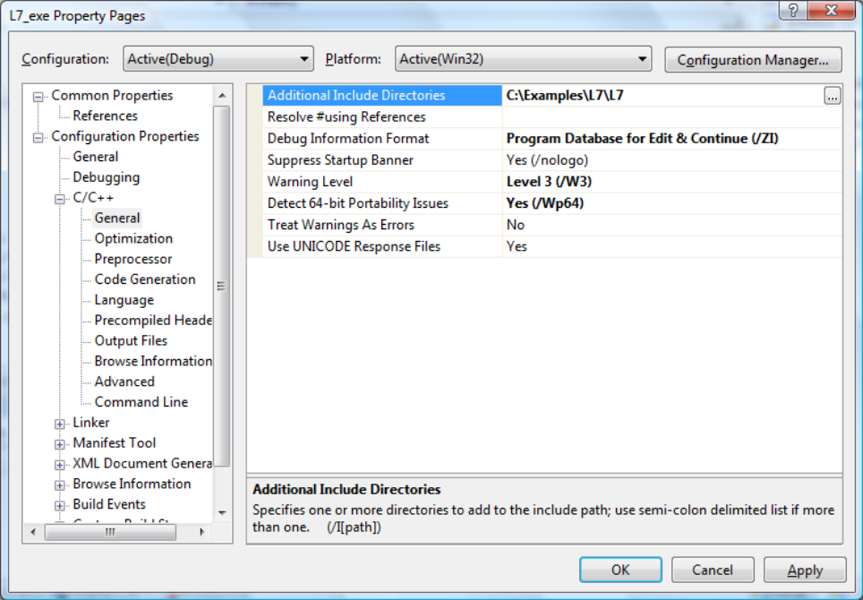
Using Static Link Libraries 1
Create Win32 Console App
Reference the library
  Select Project, Properties,
  References…
  Select Add New Reference…
Add Reference dialog
  Shows libraries in projects in current solution
Modify include directories path
  Configuration Properties C/C++, General
    Add path to header file in Additional Include Directories

Slide 9
Using Static Link Libraries 2
Using an external library
  Add the header file from the library
    Right click on the project in solution explorer
      Add, Existing Item…
  Add the library file
    Right click on the project in solution explorer
      Add, Existing Item…
      In Files of Type combo box, select All Files.
      In the list of files, select our .lib file.

Slide 10
Disadvantages of SLLs
Disadvantages
  Programs must be rebuilt if SLL changes
  Wastes memory
    If concurrent programs use same library
  Wastes disk space
    If used by many programs
However (compared with DLLs)
  Not affected by “missing library” at load time
    Since built into executable at link time
  No “incorrect version” problem at run time
  Quick to load – no linking at load time

Slide 11
Dynamically Linked Libraries
DLL
  Program linked to library at run-time
    On loading (load-time linking)
    Or while program runs (run-time linking)
      Programmer explicitly loads the library
      Programmer requests pointers to functions
  If DLL already loaded, only need to link
Library shared by concurrent programs
  However, whole library is loaded
  For SLL only used code is included
Smaller executable
  Library code isn’t included with .exe

Slide 12
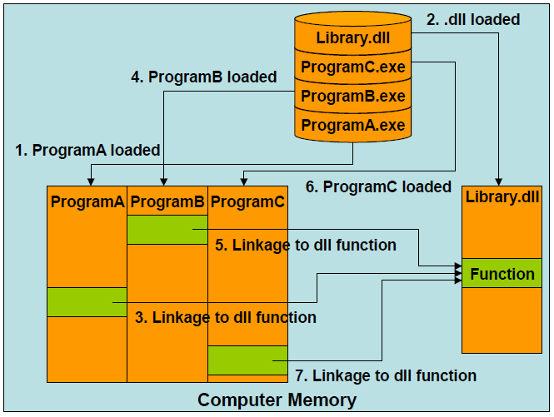
How DLLs Work
Dll loaded when A is loaded
B & C only need to link to functions
OS unloads DLL after last using program finishes

Slide 13
Advantages & Disadvantages
A function in a DLL can be improved without affecting programs that use it.
  The interface must remain the same
Improving DLL affects all user programs
  Because the link is made at run time
Can have version errors
  Especially for applications that install DLLs in the Windows System folder
  Major problem if interface is changed
    E.g. number of parameters a function expects
Why is this a problem?

Slide 14

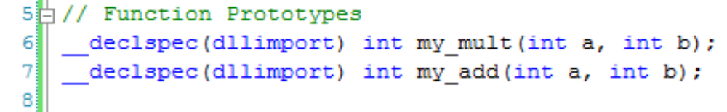
The DLL Interface
Items marked as exported are accessible
Items not exported can’t be accessed from the outside the DLL.
Used items must be marked imported
Use pre-processor directive
  so same header works in DLL & user file

Slide 15
import & export include file
  #define IMP_EXP dllimport
_declspec(IMP_EXP) void doit();
  #define IMP_EXP dllexport
_declspec(IMP_EXP) void doit();
Dlldefine.h
  #ifndef ASEXPORT
  #define IMP_EXP dllimport
  #else
  #define IMP_EXP dllexport
  #endif
  _declspec(IMP_EXP) void doit();
Dlldefine.h
What will the include file expand to?
#define ASEXPORT
Dlldefine.h
What will the include file expand to?
  _declspec(dllimport) void doit();
_declspec(dllexport) void doit();

Slide 16
The DllMain() Function
Every DLL must export DllMain().
Called by Windows after loading DLL
  The DLL can initialize itself before it’s used
    Open files
    Make network connection
    Acquire memory
Called by Windows before unloading DLL
  The DLL can clean up
    E.g. return resources, close connections

Slide 17
DllMain()
DllMain() has 3 parameters
  A handle to identify the DLL
    Created by Windows
  The reason why DllMain() is being called
    DLL_PROCESS_ATTACH
      a program is about to use the DLL
    DLL_PROCESS_DETACH
      a program has finished using the DLL
  A pointer reserved for use by Windows.

Slide 18
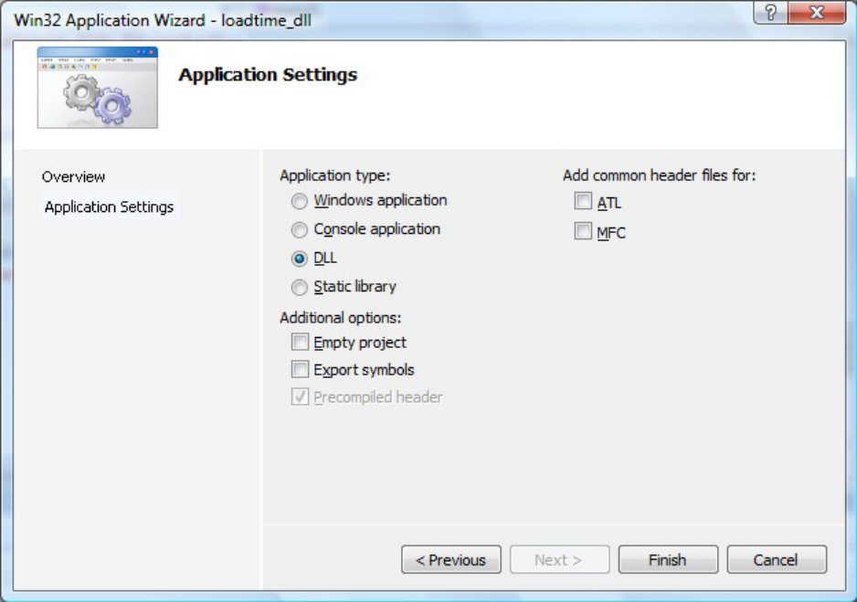
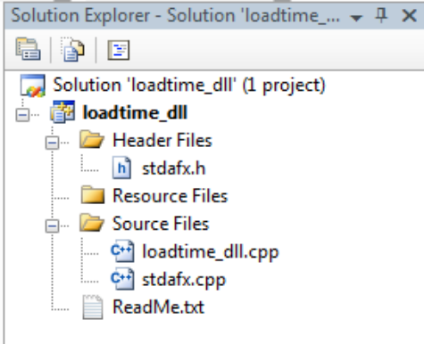
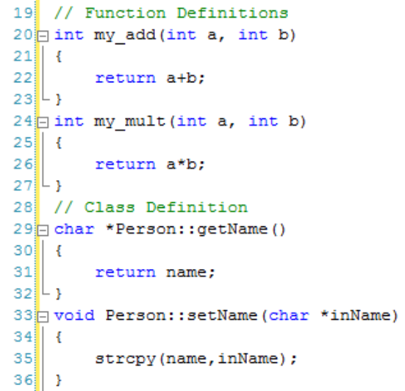
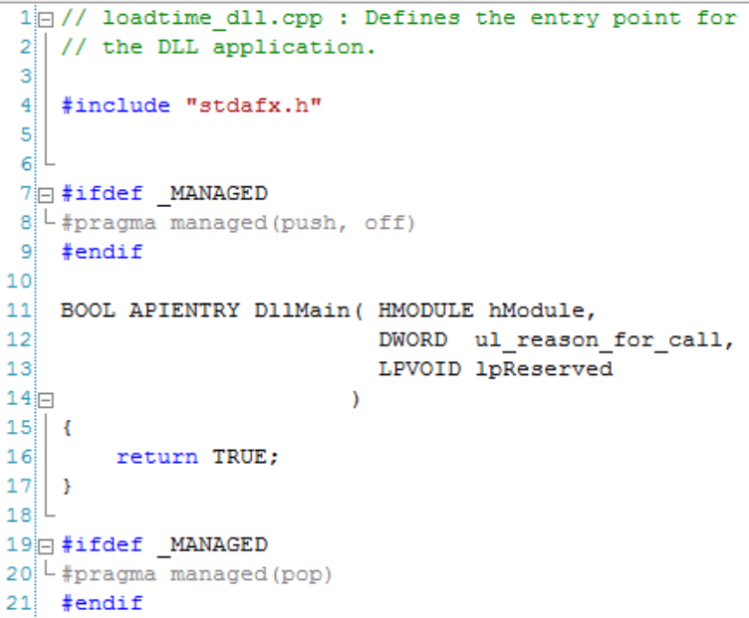
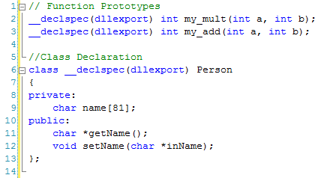
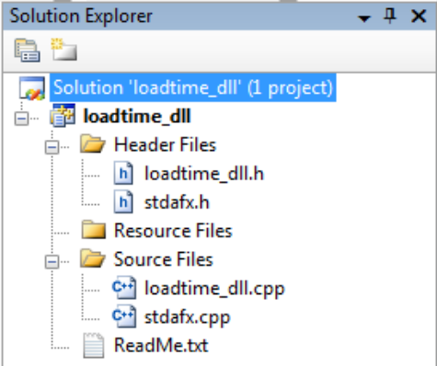
Creating DLLs
Create new Win32 project
Application Settings
  Application type
  Select DLL
Leave Additional options
unchecked
DLL structure generated
Some code generated
Add Header file
Add implementation to source file

Slide 19
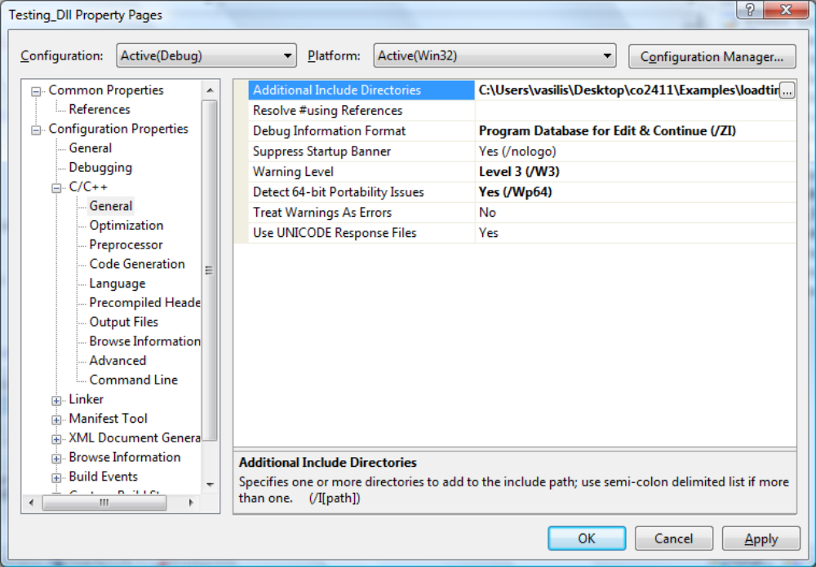
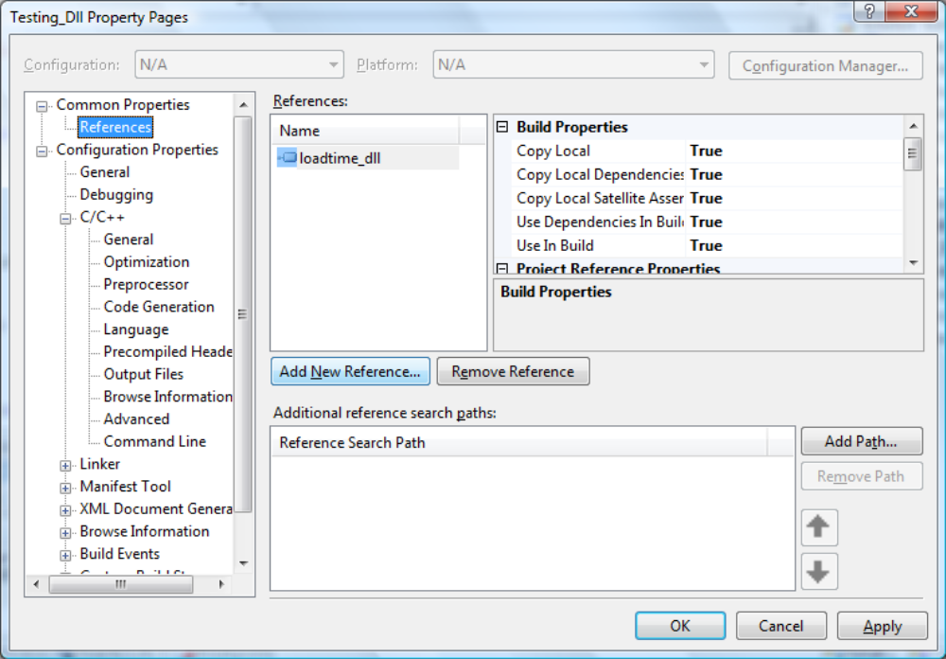
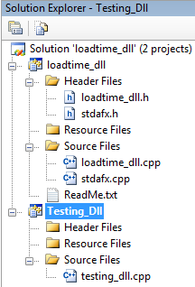
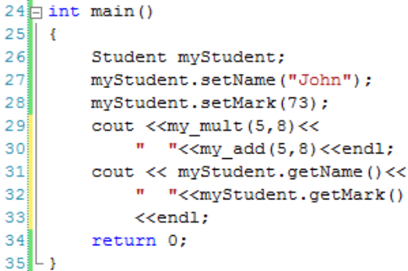
Using Load-time DLLs
Create a Win32 Console Application
Write main()
Reference the DLL
Add directory for #include header file
Build and run

Slide 20
Summary
Static library
  Relevant items bound into exe
Dynamic library
  Relevant items loaded & linked at run-time
  Load-time (OS-managed) linking
  Run-time (programmer-driven) linking
How to create and use SLL & DLL
Advantages and Disadvantages
  DLL: save disk & memory space
  DLL: incorrect version, missing library

Slide 21
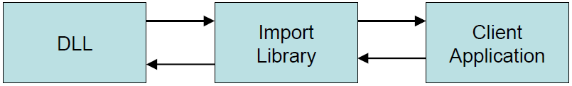
Import Library
.lib file created by builder of DLL
Contains information on available exports
  Functions provided by the DLL.
An empty table is set up in the EXE
  OS fills in addresses of exports from DLL
    At load time
Windows won’t load EXE if DLLs not found
  Searches a well defined collection of folders

